Slide 1


Examination of The Barriers to Employment Among Afghan Immigrants in Washington and the Impact on Immigrant Health
Community Perspective and Survey Responses
Researcher: Dr. Nicole Chicoine
Advisor: Ehsan Shayegan

Slide 2
Acknowledgements
Land Acknowledgement
We would like to acknowledge the Indigenous people that have and still continue to inhabit the land that this research
was conducted on and the land that we occupy. We thank the Coast Salish peoples of this land, the land which touches
the shared waters of all tribes and bands within the Duwamish, Puyallup, Suquamish, Tulalip and Muckleshoot nations
for their protection and stewardship of this land, as we acknowledge the injustices that were and continue to occur to
the Indigenous peoples.
Community and Team Acknowledgement
We extend our heartfelt thanks to our community partners, including the Kabul Washington Association (KWA), Afghan American Cultural Association, and the Hazara Community of Washington (HCWA), for their invaluable constructive feedback, consultations, and assistance in disseminating the survey questionnaire. Your support has been instrumental in the success of this project.
We are deeply grateful to the survey participants from various ethnic minority communities for their active participation in this study and for sharing their valuable perspectives. A special thanks to Rohullah Alimy and Shir Ahmad for their volunteer efforts in translating
and editing the Pashto questionnaire. We also appreciate Setara Sahar’s voluntary contribution in supporting female survey participants, assisting them in completing the survey, and reaching out to them directly. Lastly, we offer special thanks to Shir Mehryar for his unwavering support throughout the project, his dedication to community engagement, and his vital role in translating the
qualitative data. Your collective contributions have made this project possible, and we are deeply grateful
for your continued commitment and support.

Slide 3
Table of Contents
Background
Review of Literature
Methods
Results
Analysis
Recommendations

Slide 4
Rational For This Study
Scope: Our study aims to identify barriers to employment, understand their impact on health, and offer strategic interventions.
Relevance of the Study: Understanding that the Afghan immigrant population is growing in Washington, and employment barriers remain a critical problem for this population.
Research Questions:
1.What are the barriers to employment that Afghan Immigrants in Washington face?
2.What are the impacts of these barriers on health?
3.What policy or program changes can help?

Slide 5
Background
2.5 million individuals globally are registered as Afghan refugees, and they compose the second largest refugee population in the world
The US began admitting refugees, in 1980 after the passage of Refugee Act, and since that time has admitted nearly 3.1 million refugees
In 2022 after emergence of Taliban rule, as many as 2.7 million Afghan refugees have fled Afghanistan, with an estimated 86,000 moving to the U.S.
Washington has remained a top destination for these individuals, welcoming nearly 8% of the country’s total special immigration visa arrivals over the past 3 years
Evidence suggests that this population suffers from high rates of unemployment, and or underemployment, leading to high rates of poverty, increased risk of exploitation, and increased rates of emotional distress.

Slide 6
Methodology
For this project we used a mixed methods approach
Quantitative Methods:
41 question google survey developed in collaboration with community partners
Administered over 4 weeks
Available in English, Dari/Farsi, Pashto
4 domains of the survey: demographic information, employment status, employment barriers, and health outcomes
Analysis conducted in Microsoft Excel
Qualitative Methods:
Open ended questions within the survey to gain insight into participants experiences
Conducted a focus group with Community Leaders and key informants
All qualitative responses were analyzed to find key themes

Slide 7
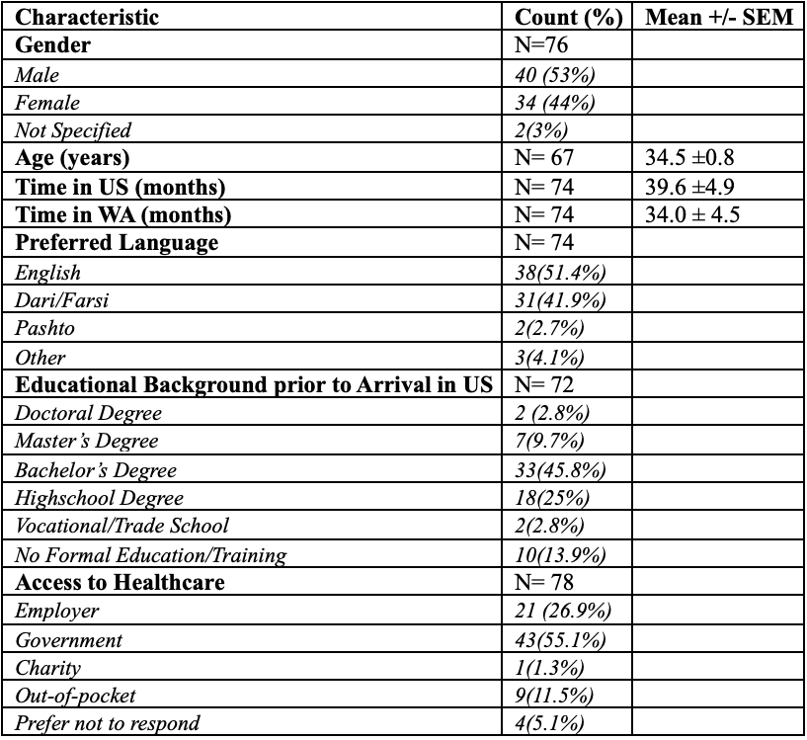
Results

Slide 8
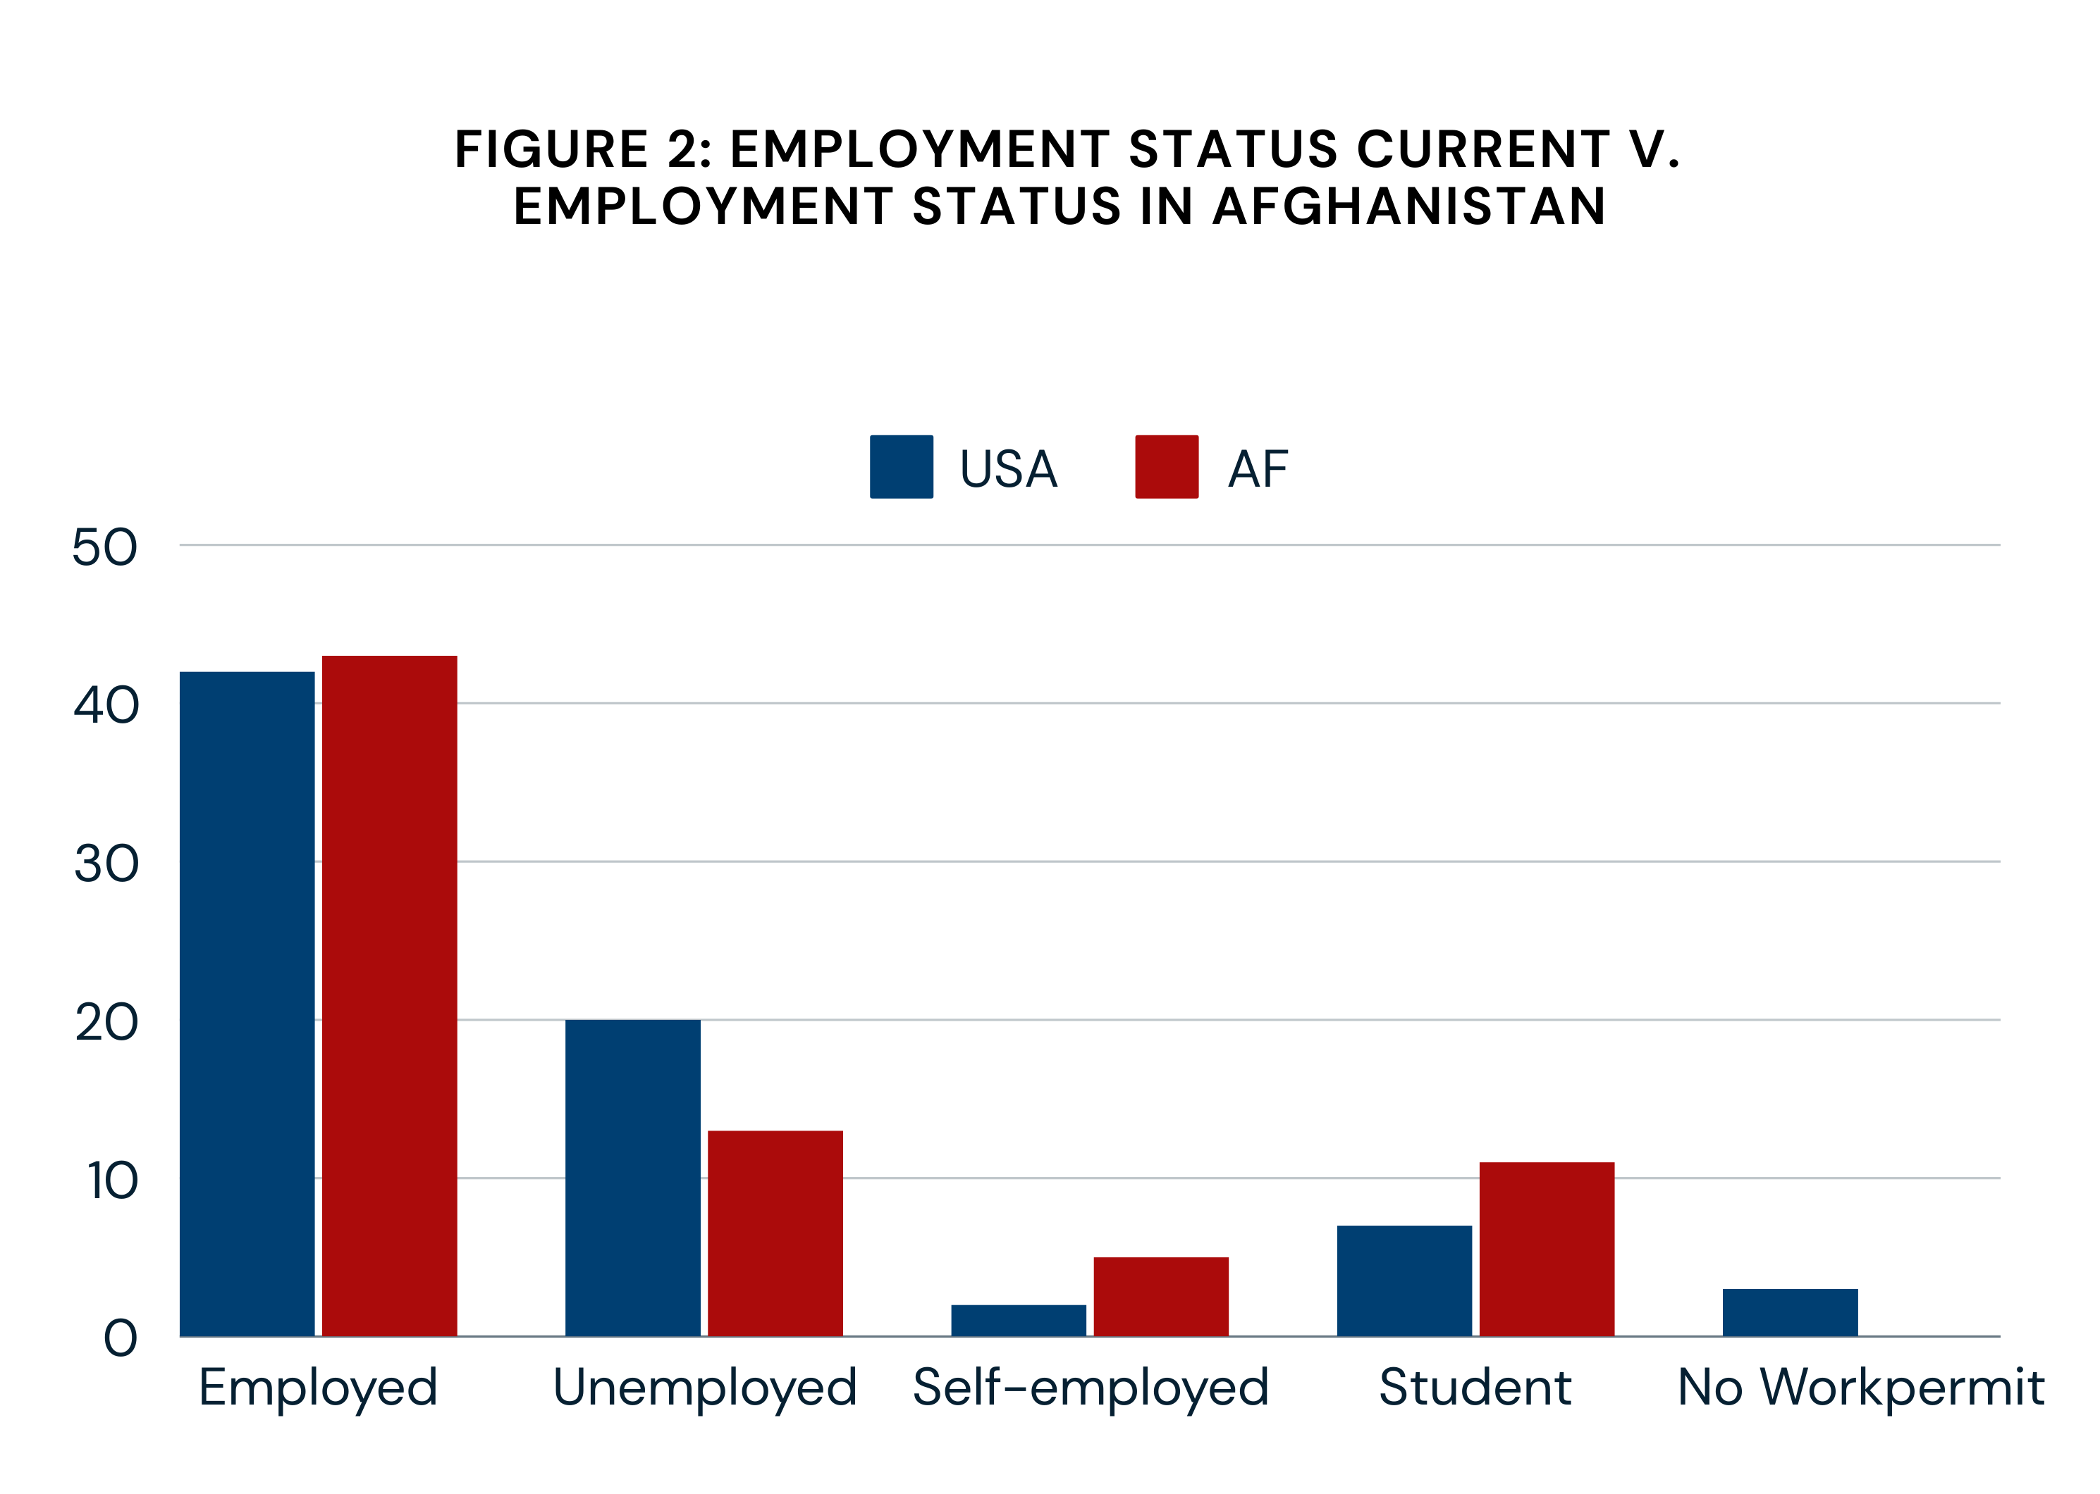
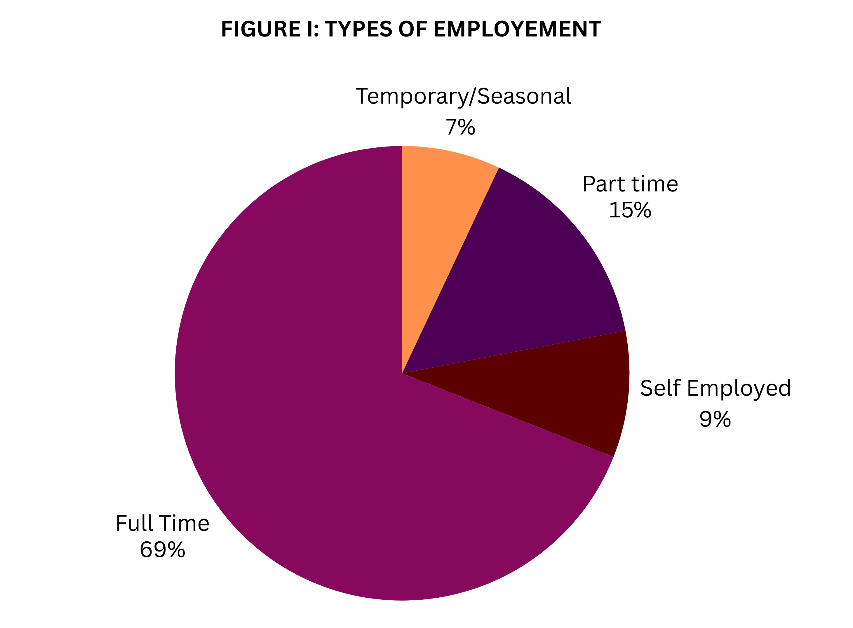
Results

Slide 9
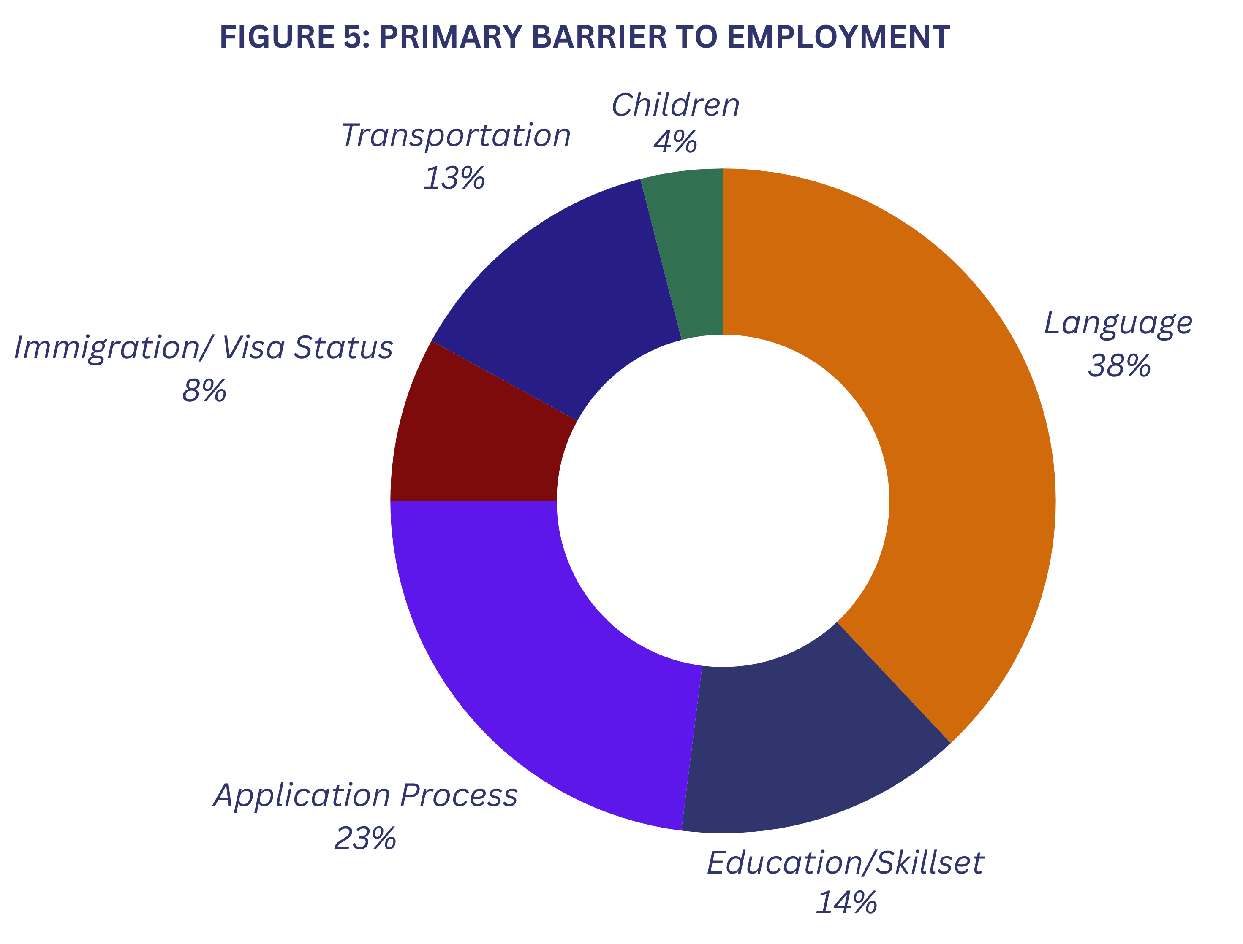
Results

Slide 10
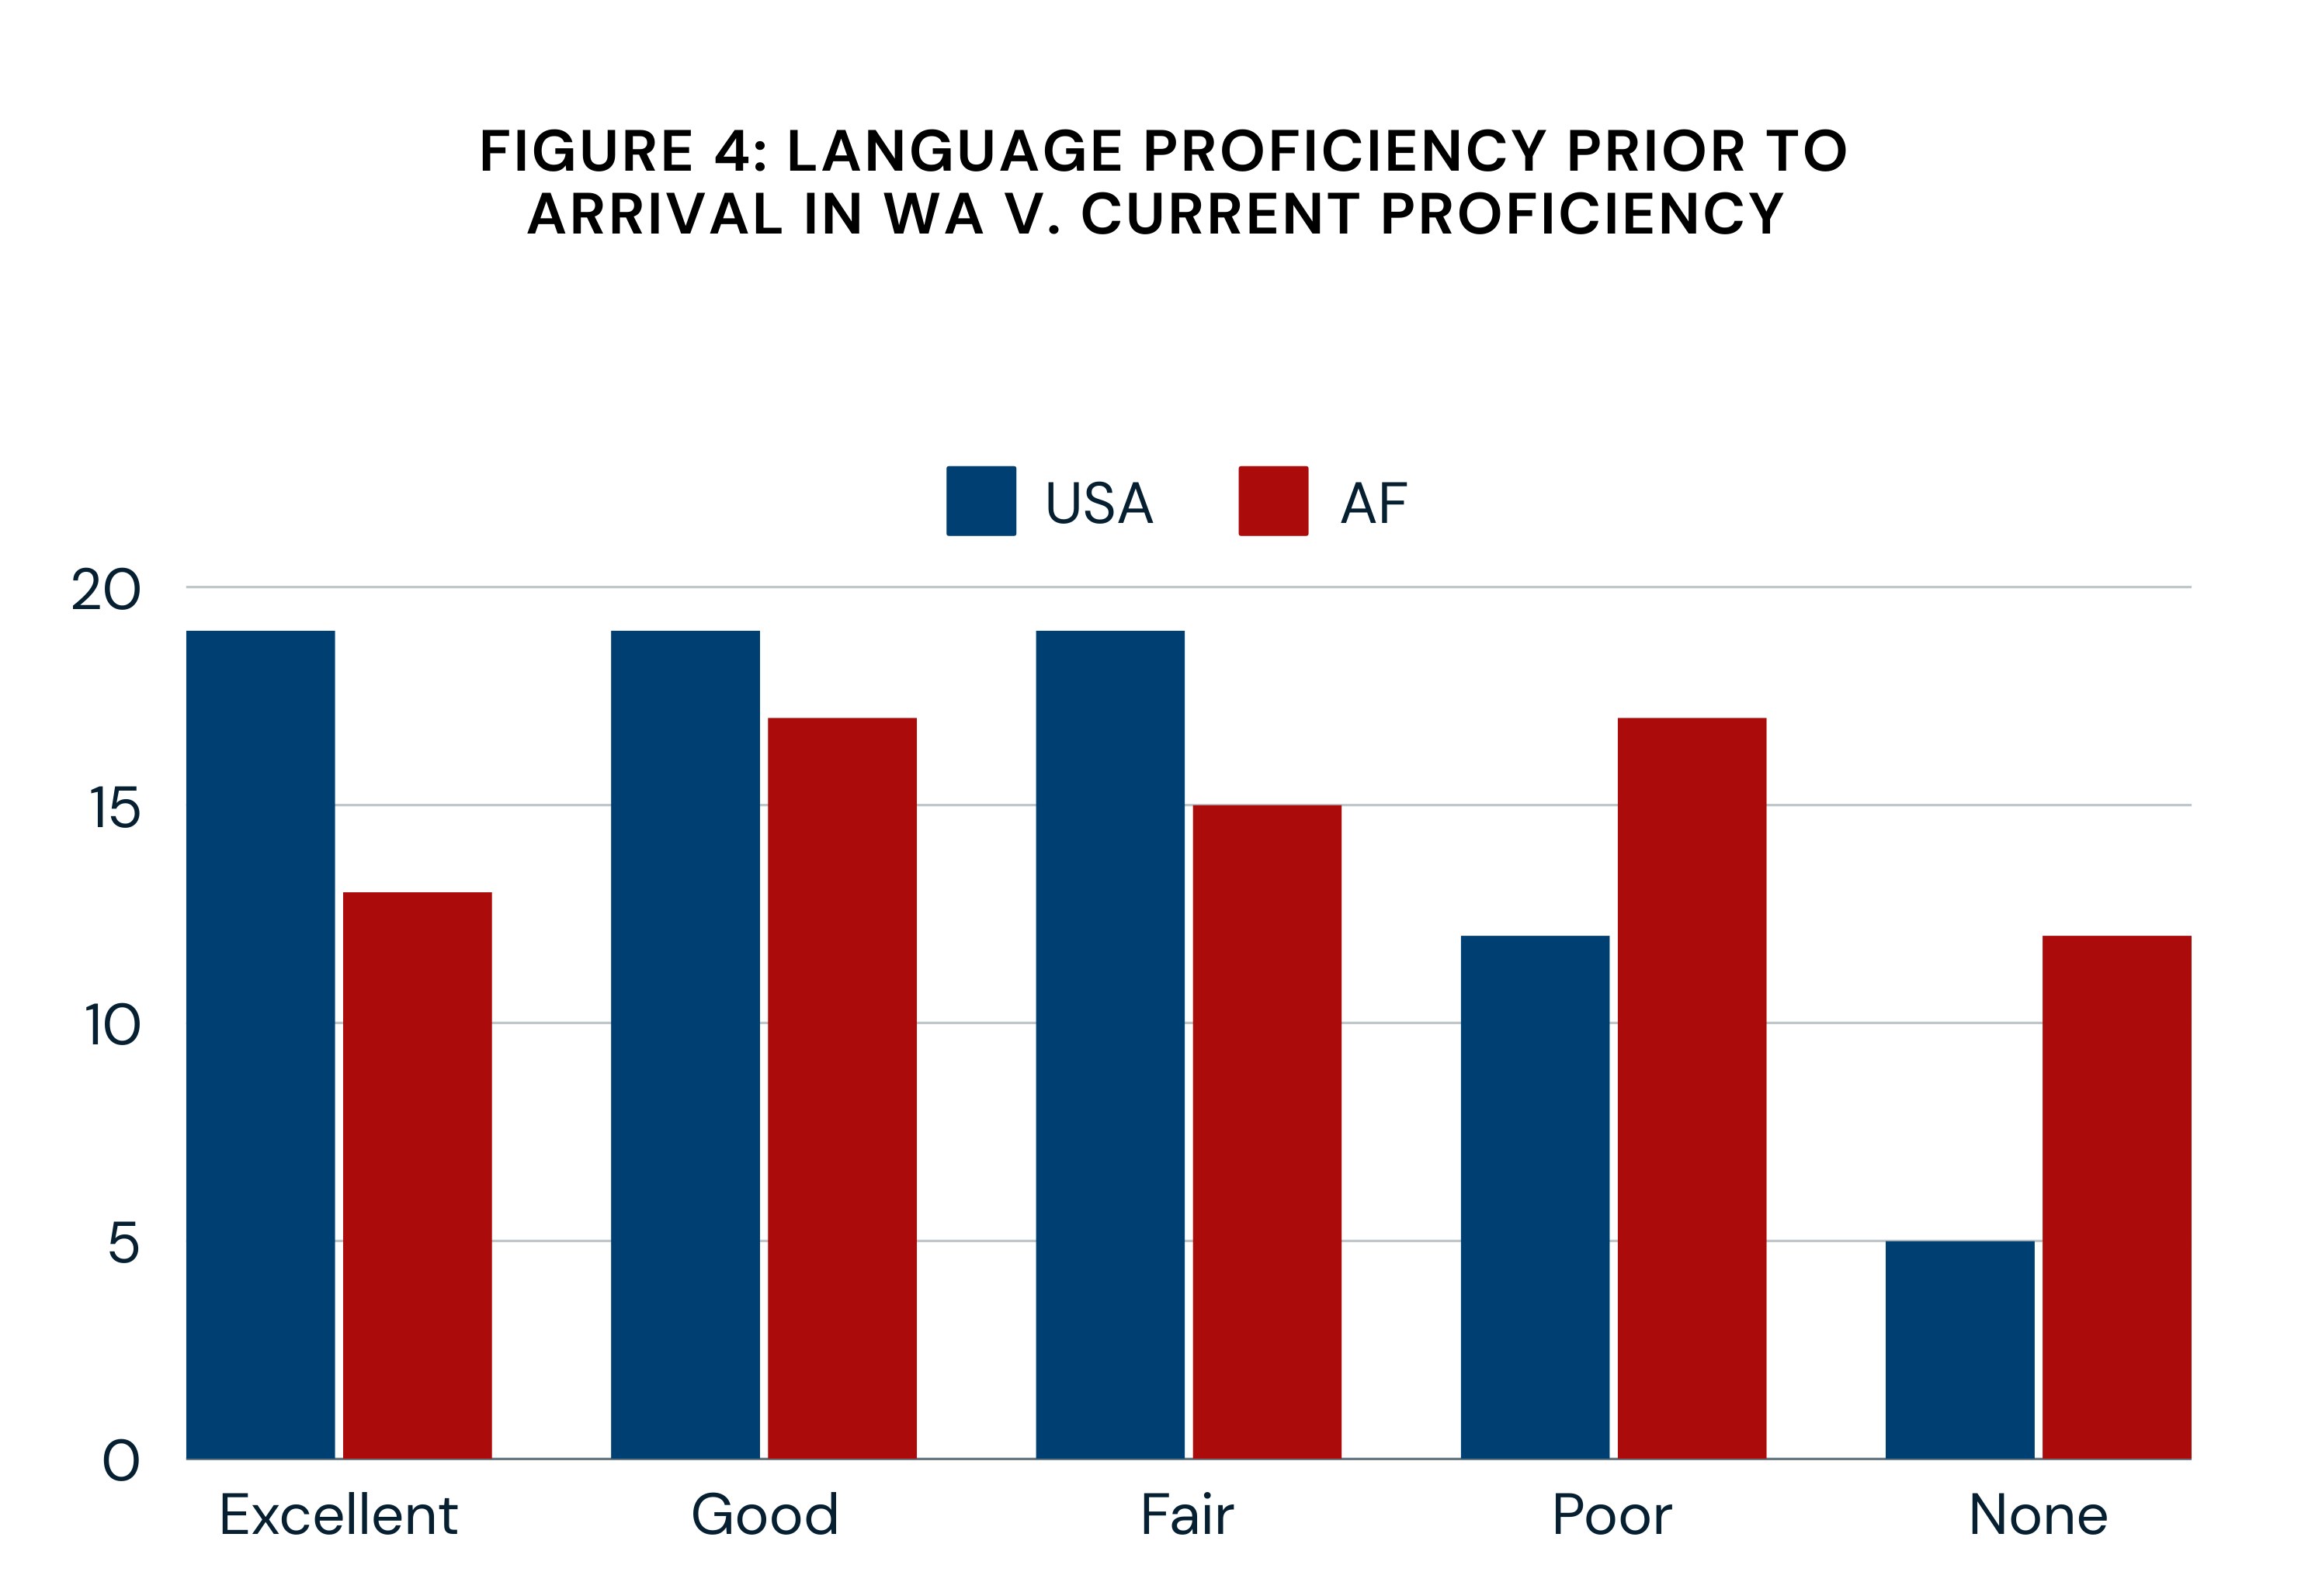
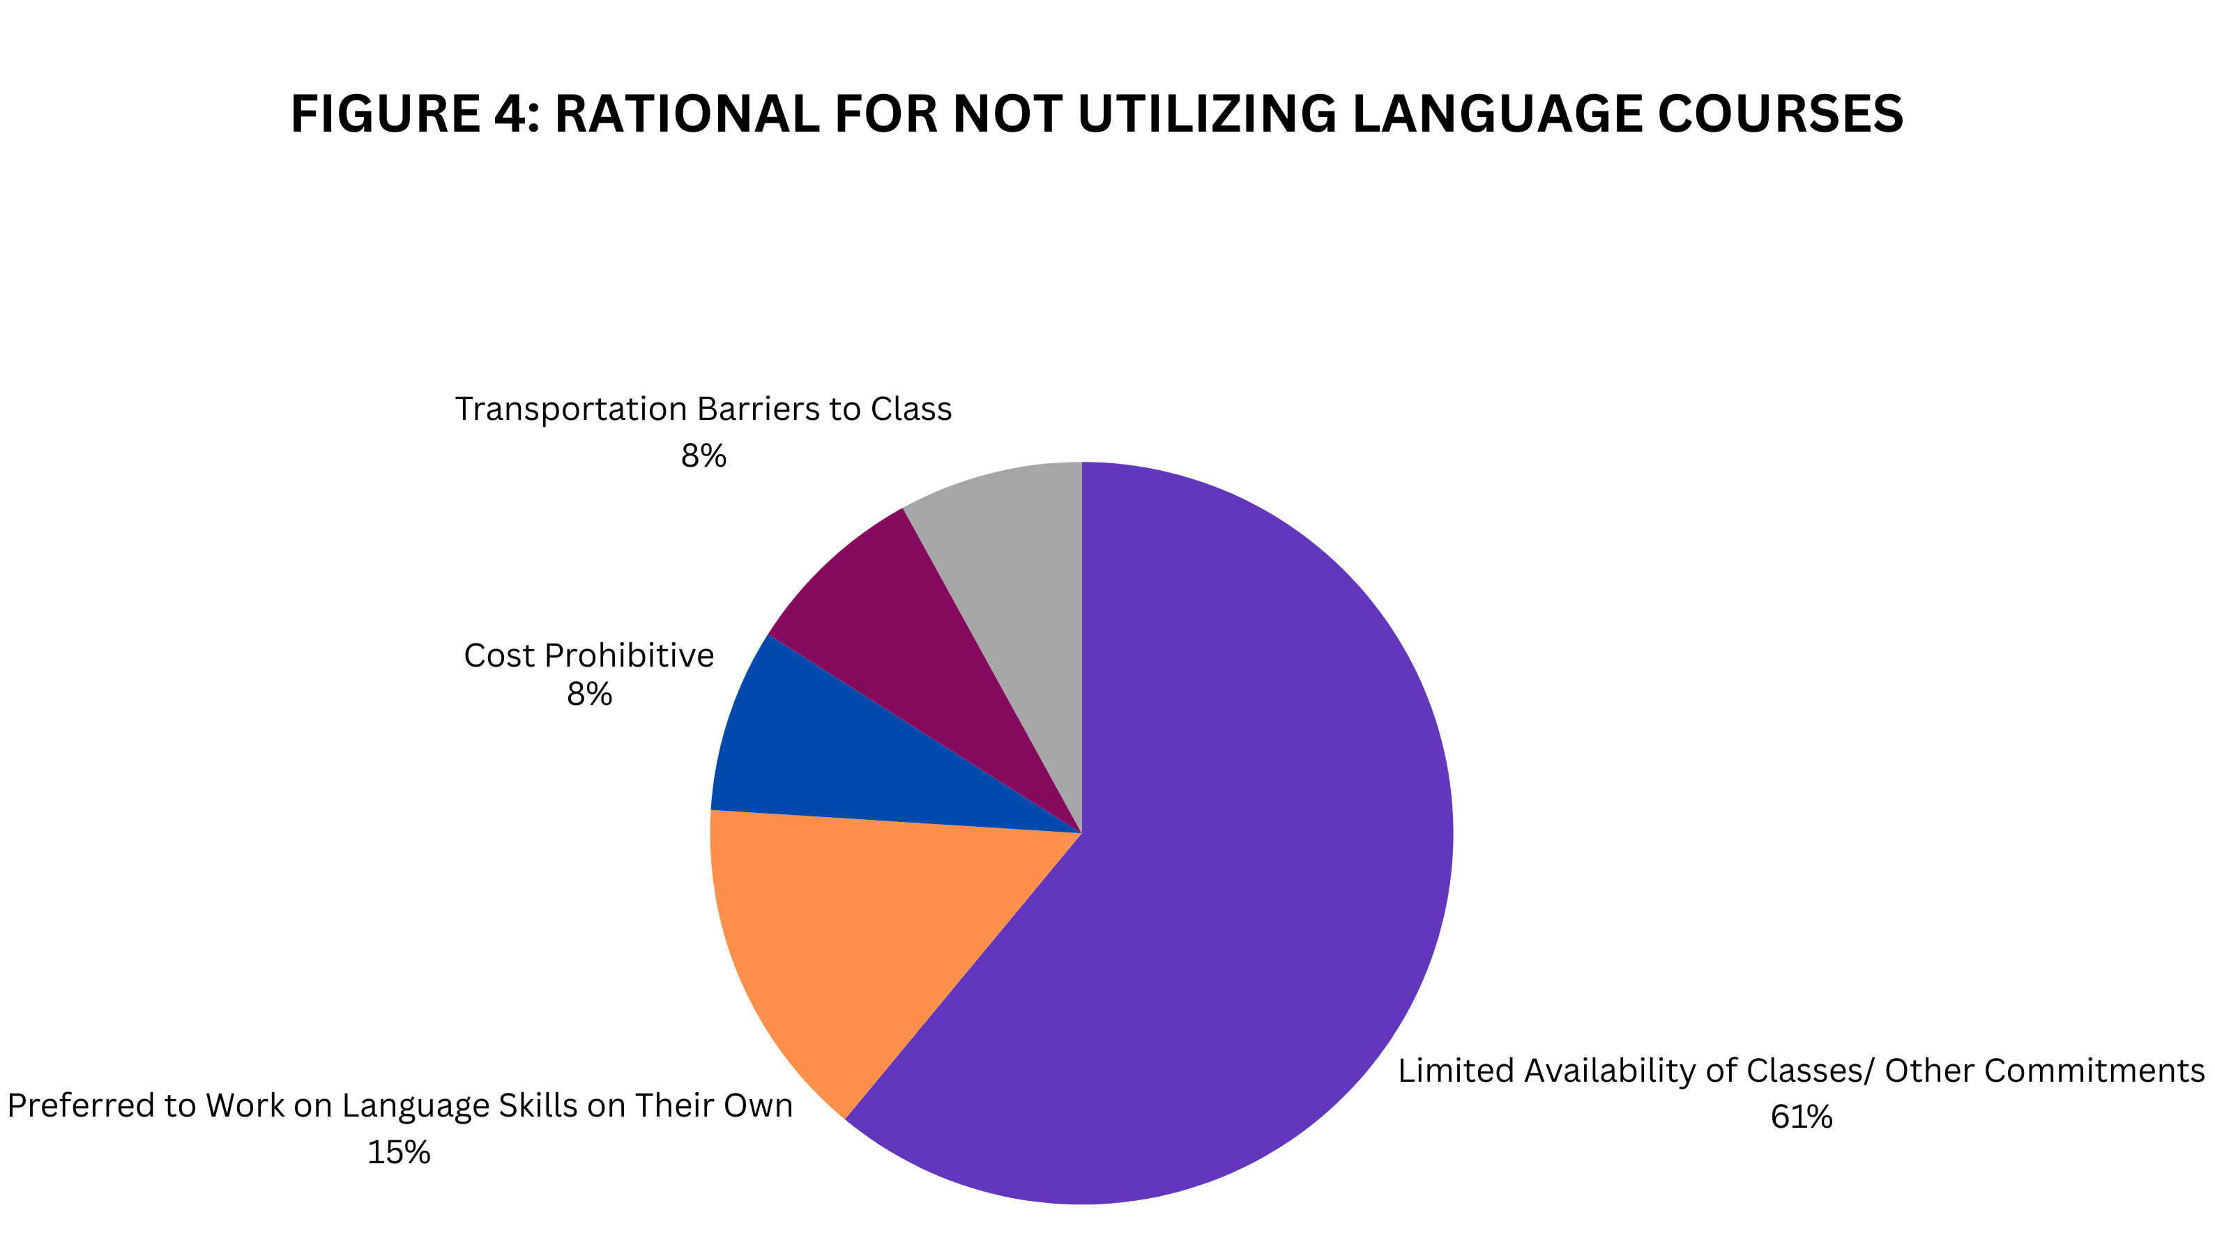
Results
3:

Slide 11
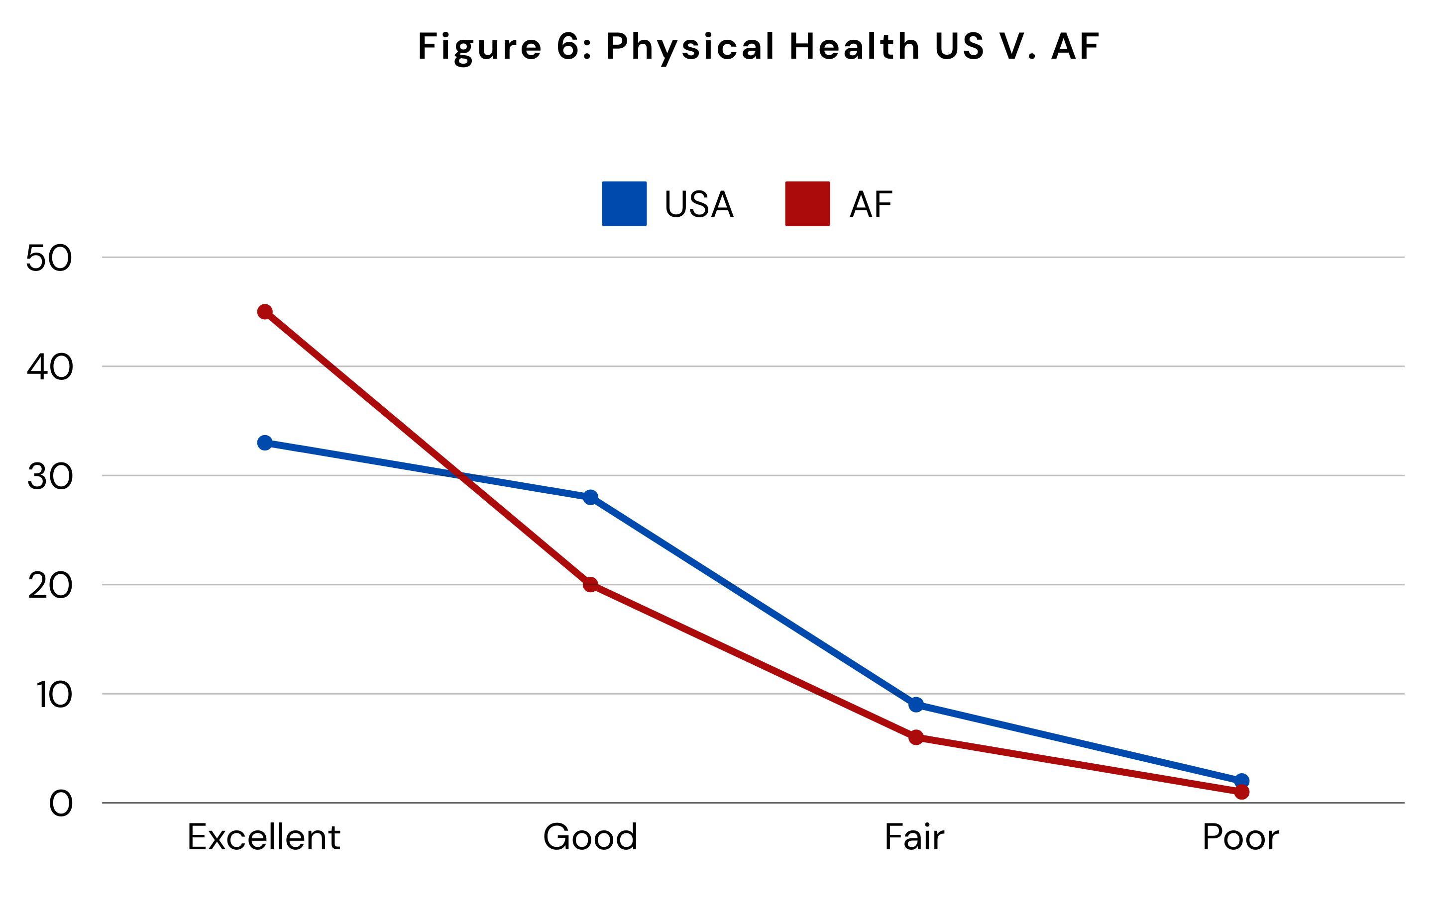
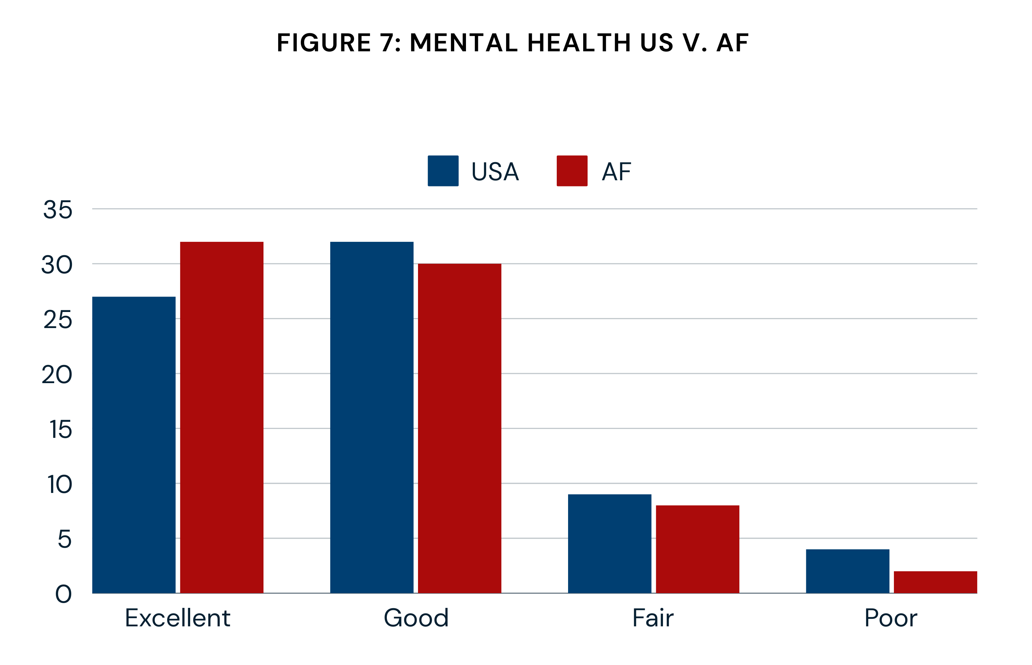
Results

Slide 12
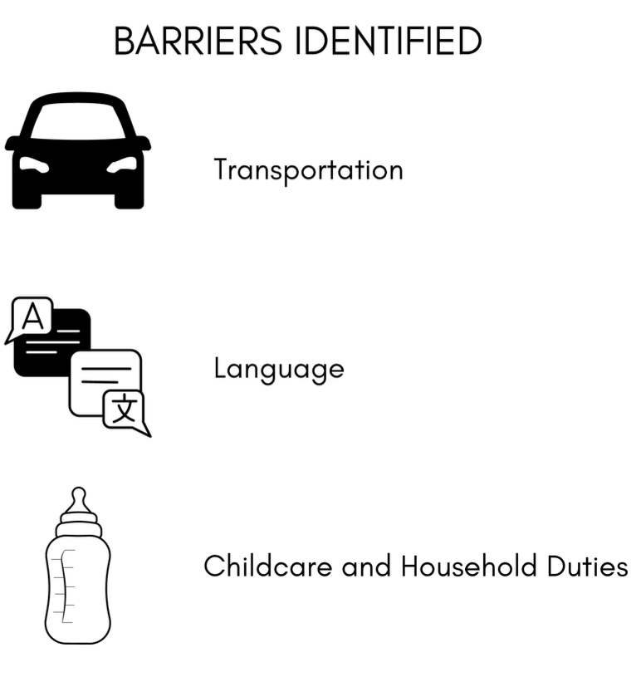
Results

Slide 13
Conclusions and Limitations
Adjustment of resettlement programming to be culturally tailored and include more education on skills/ information pertaining to the identified barriers to employment is vital.
Adjustments include adding Language education classes, soft skills (interviewing, CV preparation, information/ contacts to agencies on how to obtain a drivers license)
Limitations:
Small sample size (n=76)
Selection Bias
Language barriers
Self reported data, not objective data
Cross sectional study not a longitudinal study

Slide 14

WE
THANK YOU
FOR YOUR ATTENTION
For Any Question or Collaboration Please Email us at: president@prresearch.us
https://prresearch.us/
Notes:
Watch Transition Story:

Slide 15
Questions & Answers

